Slide 1
Sentiment and Opinion
Members
Keli Dara-Ahato | Merve Güzeldal
Pascal Breuer | Patrick Neumann
Xuefeng Song | Marleen Matjeka

Slide 2
What we did
Filter and analyse Sentiment-Datasets, and split them into Training, Test-Data
T-Test for to compare our Classifier with Baseline-Classifier
Probability of right classification
Process Bert to run faster
Apply Classifiers to our new Sentiment-Datasets
Discuss about finding New Opinion Datasets and start looking for them

Slide 3
Probability of right classification
With our old Dataset:
for sentiment
predicted class = 0 and confidence = 79.84%
predicted class = 1 and confidence = 74.09%
for opinion
predicted class = 0 and confidence = 98.96%
predicted class = 1 and confidence = 73.61%

Slide 4
T-Test added
Added a T-Test Module
to compare our Classifier with Baseline-Classifier.

Slide 5
Too long sentences
We stayed at Omni Chicago for 2 nights in early July (July 1-3). The reason we chose this hotel was simply because of a great deal we got on TravelZoo. We got pretty good rate that included a valet parking and vouchers for food&beverages. I also signed up for their loyalty program, which was so worth it. I was concerned at first that we would be treated like a second-class guest because of the price we paid. But I was totally wrong! They treated us extremely well. Before our arrival, I got an email asking if we needed anything. So, I asked for a fridge to store the baby milk. And they arranged it for us without charge :) We arrived late on Thursday night. Our room was ready for us upon our arrival with the fridge I requested. We were given a corner suite on the 10th floor...very nice room...comfy bed. My husband was really wowwwww!!! The bed was made ready for us - both in the bedroom and the sofa-bed (we didn't use the sofa-bed though). We got a high-speed Internet as part of the loyalty program. All staff were friendly and helpful...front desk, valet parking, bell boy, room service, concierge,... everyone! We used the voucher for room-service breakfasts both morning. The first day was great. Food was great, and quick. We also got complimentary beverages as part of the loyalty program. We ordered OJ and hot chocolate. They both were so good that we ordered them again the next morning. But we were very disappointed that the hot chocolate tasted pretty horrible. It tasted like left-over coffee mixed with water and a bit of chocolate :( Also, we ordered Belgian waffle for our breakfast, which was supposed to come with whipped cream and strawberries...but we got a plain waffle. So, we had to call the restaurant and wait for a while to get those. This is why I didn't give '5' for service. However, I reported these issues to the front-desk when checking out, and the front-desk staff took care of it by not charging us for that meal. Another thing is that it's quite noisy at night even though we were on the high floor. We could hear siren going on & off during the night. But this is out of the hotel's control though. And I would say that it didn't bother us at all. My baby could sleep very well. Overall, we really enjoyed our stay, and would definitely consider Omni for our next trip to Chicago.

Slide 6
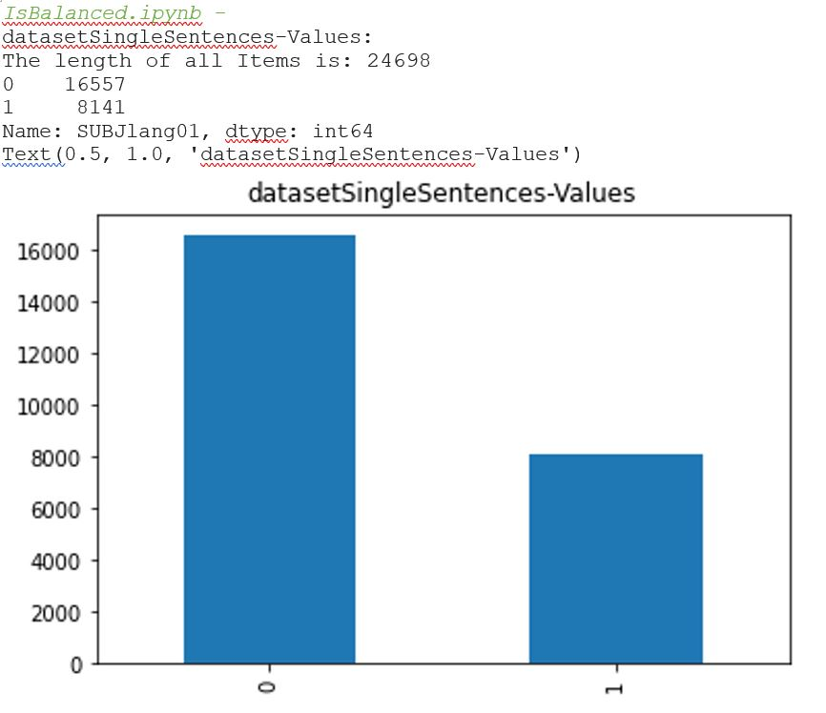
Filter the too long sentences

Slide 7
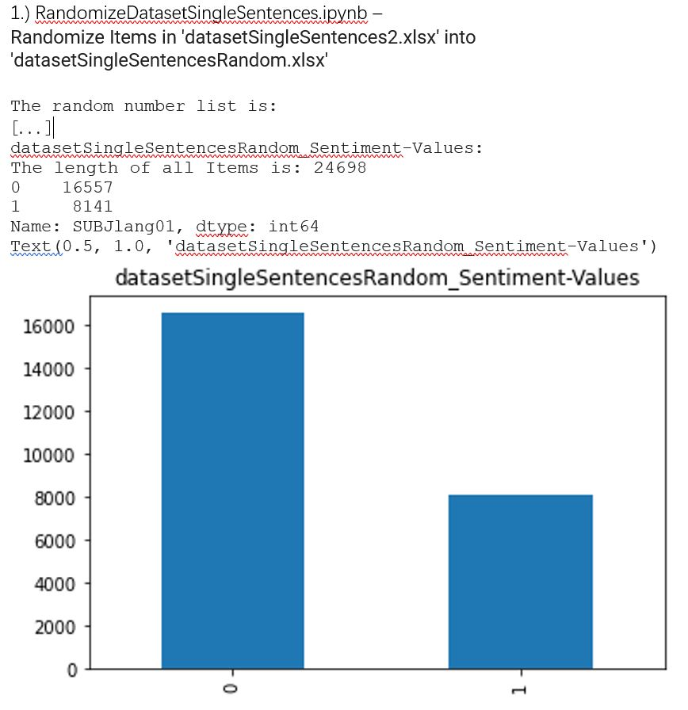
Randomize Order
of Items in the filtered dataset

Slide 8
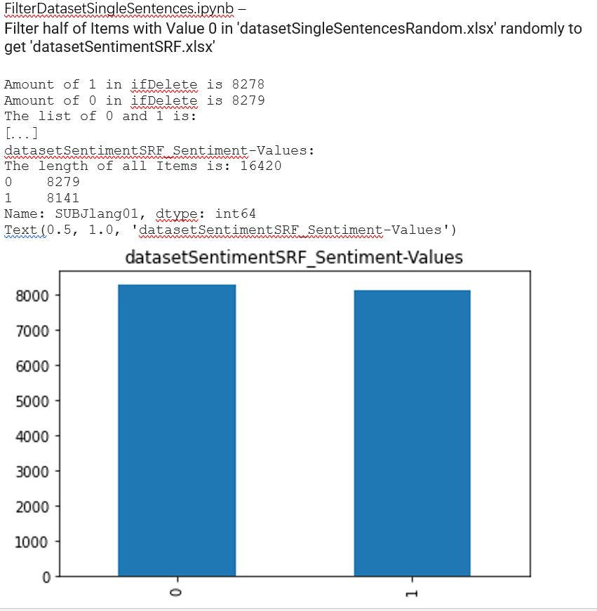
Balance the
filtered dataset

Slide 9
Split the Dataset and check if they are balanced
SplitDatasetSentimentSRF.ipynb –
Split 'datasetSentimentSRF.xlsx' into 'datasetSentimentSRF_Train.xlsx', 'datasetSentimentSRF_Test.xlsx' and 'datasetSentimentSRF_Validation.xlsx'
datasetSentimentSRF_train_Sentiment-Values:
The length of all Items is: 11494
0 5797
1 5697
datasetSentimentSRF_test_Sentiment-Values:
The length of all Items is: 2463
0 1262
1 1201
datasetSentimentSRF_validation_Sentiment-Values:
The length of all Items is: 2463
1 1243
0 1220

Slide 10
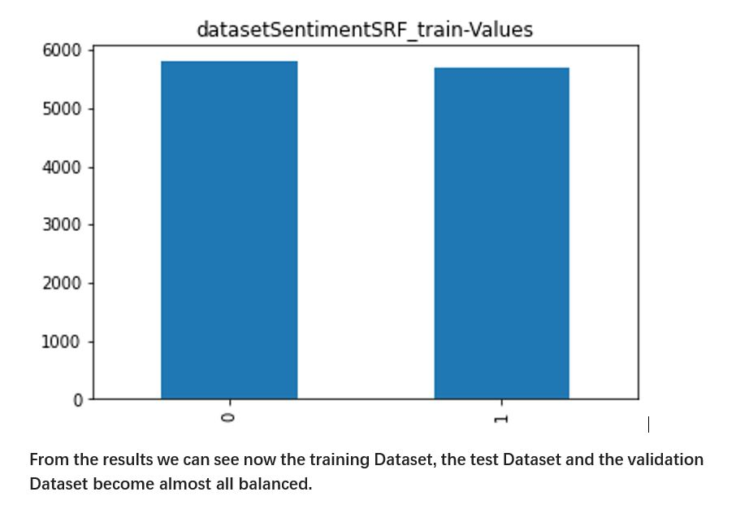
Split the Dataset and check if they are balanced

Slide 11
Problem with BERT solved
Build BERT to process Data bit by bit
without strong RAM storage capacity.

Slide 12
Apply Classifier to our new Sentiment-Datasets
 | Classifier | Accuracy | Precision | Recall | f-Score
Sentiment | Textblob and Pattern3 | 0.57 -> 0.534 | 0.53 -> 0.544 | 0.57 -> 0.534 | 0.54 -> 0.483
Opinion | Textblob and Pattern3 | 0.57 | 0.57 | 0.57 | 0.57
Sentiment | Vader | 0.62 -> 0.506 | 0.61 -> 0.499 | 0.62 -> 0.506 | 0.61 -> 0.460
Sentiment | Logistic Regression | 0.65 -> 0.626 | 0.64 -> 0.626 | 0.65 -> 0.626 | 0.63 -> 0.626
Opinion | Logistic Regression | 0.68 | 0.65 | 0.68 | 0.63
Notes:
Aker 说此比较无意义，因为Test-Dataset不同。

Slide 13
Look for new Opinion Datasets
Variable: SUBJopin
The authors try to convince the reader of their opinion.
O Strongly Disagree
O Disagree
O Partly Disagree/partly agree
O Agree
O Strongly agree
To find Datasets
to differentiate/determine Opinion or Fact.
to determine if a Sentence includes Opinions.

Slide 14
Look for new Opinion Datasets
To find Datasets
to differentiate/determine Opinion or Fact.
to determine if a Sentence includes Opinions.
https://github.com/fractalego/subjectivity_classifier/tree/master/data/subj_dataset
four Texts -> "opinionDataset.xlsx".

Slide 15
Next week
Continue the task in progress
T-Test
Probability of right classification
Apply new Datasets
Search for new opinion datasets,
then merge and continue preprocessing them

